Slide 1
IMAGES

Slide 2
Introduction
Still images are the important element of a multimedia project or a web site.
  To make a multimedia presentation look elegant and complete.
It is necessary to spend ample amount of time to design the graphics and the layouts.
Competent, computer literate skills in graphic art and design are vital to the success of a multimedia project.

Slide 3
Digital Image
A digital image is represented by a matrix of numeric values each representing a quantized intensity value.
  When I is a two-dimensional matrix, then I(r,c) is the intensity value at the position corresponding to row r and column c of the matrix.
The points at which an image is sampled are known as picture elements
commonly abbreviated as pixels.
The pixel values of intensity images are called gray scale levels (we encode here the “color” of the image).
The intensity at each pixel is represented by an integer and is determined from the continuous image by averaging over a small neighborhood around the pixel location.
If there are just two intensity values, for example, black, and white, they are represented by the numbers 0 and 1; such images are called binary-valued images.
If 8-bit integers are used to store each pixel value, the gray levels range from 0 (black) to 255 (white).

Slide 4
Digital Image Format
Captured Image Format
  The image format is specified by two main parameters: spatial resolution, which is specified as pixels x pixels (eg. 640x480)and color encoding, which is specified by bits per pixel.
  Both parameter values depend on hardware and software for input/output of images.
Stored Image Format
  When we store an image, we are storing a two-dimensional array of values, in which each value represents the data associated with a pixel in the image. For a bitmap, this value is a binary digit.

Slide 5
Bitmap
A bitmap is a simple information matrix describing the individual dots that are the smallest elements of resolution on a computer screen or other display or printing device.
A one-dimensional matrix is required for monochrome (black and white);
Greater depth (more bits of information) is required to describe more than 16 million colors the picture elements may have.
The state of all the pixels on a computer screen make up the image seen by the viewer, whether in combinations of black and white or colored pixels in a line of text, a photograph-like picture, or a simple background pattern.

Slide 6
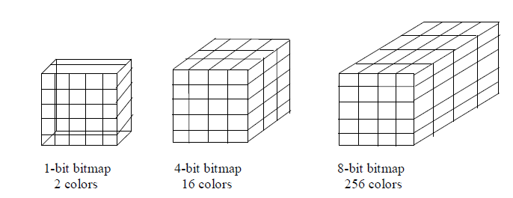
Bitmap

Slide 7

Graphics Software Programs
Drawing programs – Adobe Illustrator
Paint programs – Paint Shop Pro
Image-editing programs – Photoshop (does the work of all 3)

